Slide 1
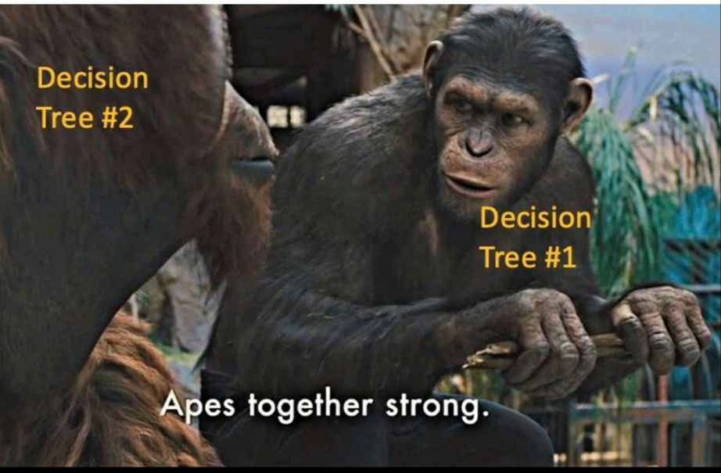
Ensemble of tree-based models

Slide 2
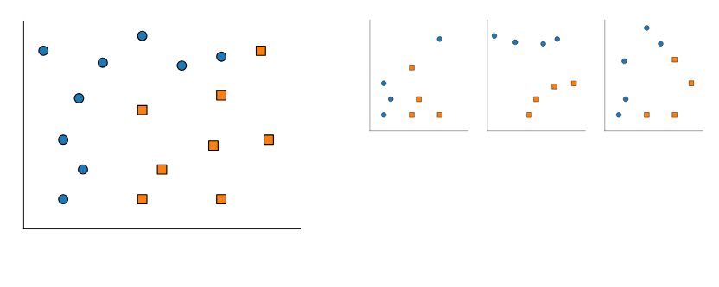
Part 1: bagging and random forests

Slide 3
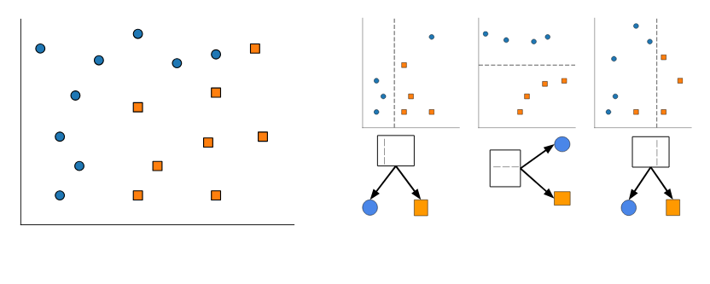

Slide 4
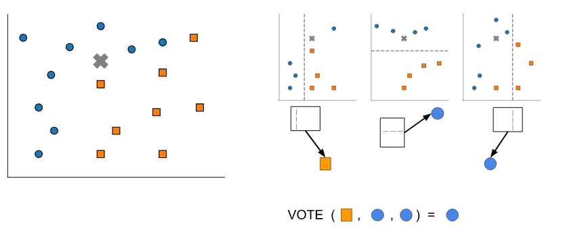

Slide 5
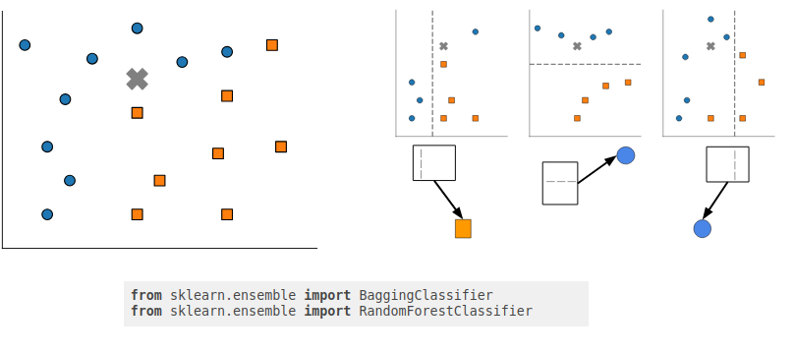

Slide 6
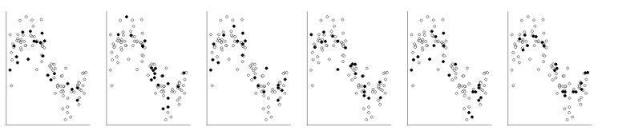
Bagging for regression
Select multiple random subsets of the data

Slide 7
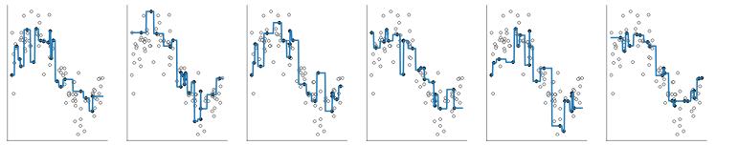
Bagging for regression
Select multiple random subsets of the data
Fit one model on each

Slide 8
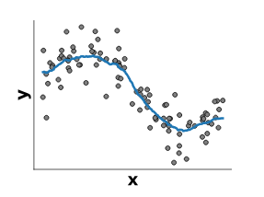
Bagging for regression
Select multiple random subsets of the data
Fit one model on each
Average predictions

Slide 9
Bagging versus Random Forests
Bagging is a general strategy
Can work with any base model (linear, trees...)
Random Forests are bagged randomized decision trees
At each split: a random subset of features are selected
The best split is taken among the restricted subset
Extra randomization decorrelates the prediction errors
Uncorrelated errors make bagging work better

Slide 10
Introductory example to ensemble models
ensemble_introduction.ipynb
Is bagging really worth it?

Slide 11
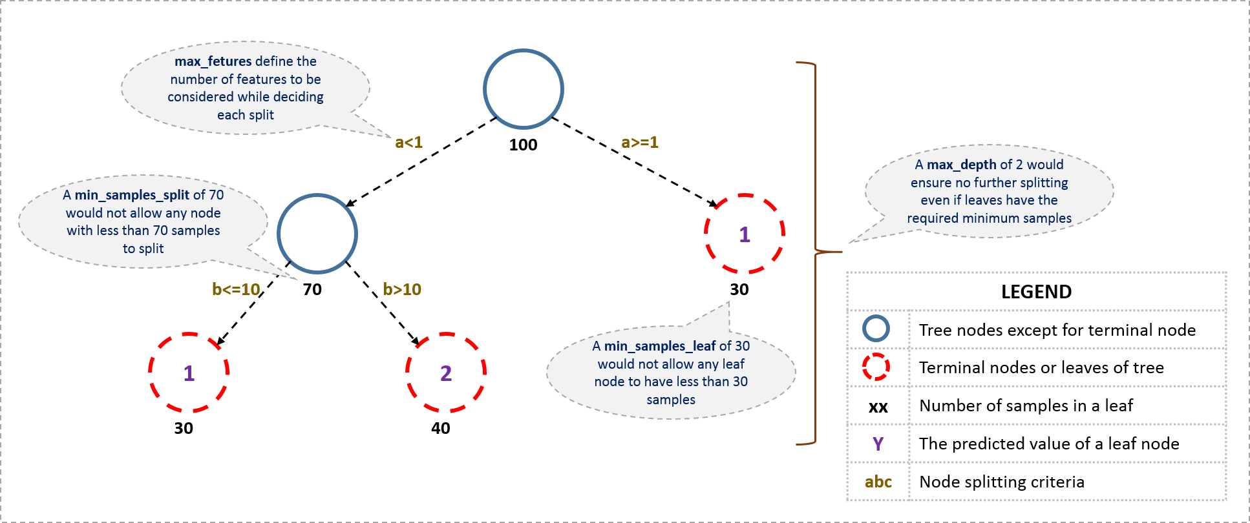

Slide 12
Bagging: any classifier or regressor can be used
Random forests: Base classifier/regressor is always a decision tree

Slide 13
Random_forest_face_recognition.ipynb
random_forest_feature_importance.ipynb

